Slide 1

SAFE SPACES
PRESENTATION DECK
SAFE SPACES
OCT X 2025

Slide 2
Agenda
+ PROBLEM STATEMENT
Definition of the problem supported by data and evidence; main pain points and impact on affected groups.
+ SOLUTION
Overview of the solution, its function, and key features addressing the identified problem.
+ CUSTOMER SEGMENTS
Target users and paying customers, including key characteristics, needs, and motivations.
+ UNIQUE VALUE PROPOSITION
Distinct value offered, competitive differentiation, and core user benefits.
+ DISTRIBUTION CHANNELS
Platforms, access points, and strategies for reaching and engaging users.
+ GROWTH METRICS
Key indicators of success such as user growth, engagement, partnerships, and revenue.
+ UNFAIR ADVANTAGE
Competitive strengths, unique expertise, technology, and partnerships.
+ COST STRUCTURE
Primary expenses for development, operations, and scaling.
+ REVENUE STREAMS
Income sources through pricing models, subscriptions, and partnerships.
+ DATA SECURITY & INTEGRITY
Measures and protocols ensuring user data is safe, reliable, and handled with trust throughout the platform.
+ SSDLC
Secure Software Development Life Cycle.
SAFE SPACES
OCT X 2025
2

Slide 3
01
Problem
Statement
SAFE SPACES
OCT X 2025
3

Slide 4

Problem Statement
Gender-based violence (GBV) remains a national crisis in South Africa, with thousands of incidents reported monthly and many more going unreported.
Victims often have no immediate access to safe spaces or rapid emergency response.
Existing safety systems are fragmented, slow, and lack real-time coordination between communities, businesses, and law enforcement.
SAFE SPACES
OCT X 2025
4

Slide 5
02
Solution
SAFE SPACES
OCT X 2025
5

Slide 6
Solution
A community-driven safety Web Progressive App (PWA) that connects individuals, local businesses, and law enforcement to prevent and respond to GBV and public safety threats.
The app allows businesses and public spaces to register as verified safe zones, integrates a panic button and voice-activated SOS function linked to police, and introduces South Africa own first crime-tracking API for real-time data and response optimization.
SAFE SPACES
OCT X 2025
6

Slide 7
03
Customer
Segments
SAFE SPACES
OCT X 2025
7

Slide 8

Customer Segments
Primary users include women, children, and other vulnerable individuals seeking protection.
Secondary users are local businesses and organizations registering as safe spaces.
Institutional customers include law enforcement, NGOs, and corporate partners interested in safety analytics and CSR-driven community impact.
SAFE SPACES
OCT X 2025
8

Slide 9
04
Unique Value
Proposition
SAFE SPACES
OCT X 2025
9

Slide 10



Unique Value Proposition
A trusted, technology-powered safety network that transforms everyday spaces into verified safe havens.
The platform combines emergency response, evidence capture, and community data intelligence in one system — bridging the gap between citizens and law enforcement while promoting safety transparency.
SAFE SPACES
OCT X 2025
10

Slide 11
05
Distribution
Channels
SAFE SPACES
OCT X 2025
11

Slide 12

Distribution Metrics
Access through mobile and web applications, available via app stores and direct registration portals.
Awareness and adoption driven by social media campaigns, community outreach, NGO partnerships, and corporate safety initiatives.
Integration with municipal and law enforcement networks ensuring institutional uptake.
SAFE SPACES
OCT X 2025
12

Slide 13
06
Growth
Metrics
SAFE SPACES
OCT X 2025
13

Slide 14

Growth Channels
Initial traction measured through app downloads, number of verified safe spaces, and partnerships with police and NGOs.
Success indicators include reduction in emergency response times, active daily users, and API data usage by research and policy institutions.
Target: 10,000 downloads and 20 registered safe spaces within the first eight months of launching.
SAFE SPACES
OCT X 2025
14

Slide 15
07
Unfair
Advantage
SAFE SPACES
OCT X 2025
15

Slide 16

Unfair Advantage
First platform in South Africa to merge verified safe zones, real-time alerts, and a crime-tracking API.
Strategic collaborations with law enforcement and local businesses ensure credibility and adoption.
Proprietary cloud-based evidence system and multilingual support to enhance accessibility and trust.
A platform meant to stay for good, for the good of everyone deserving/in need.
SAFE SPACES
OCT X 2025
16

Slide 17
08
Cost
Structure
SAFE SPACES
OCT X 2025
17

Slide 18

Cost Structure
Core expenses include software development, hosting and cloud storage, cybersecurity, geolocation infrastructure, and marketing. Additional costs cover legal compliance, community verification, and partnership onboarding.
The ideal estimated prototype and launch budget: R300,000 – R700,000.
SAFE SPACES
OCT X 2025
18

Slide 19
Cost Structure - Breakdown
App Development Cost Summary (South Africa)
Development (Frontend + Backend + Integrations): R260,000 – R950,000
UI/UX Design & Branding: R15,000 – R30,000
Firebase Cloud Storage & Hosting: ~R800 – R1,300/month additional infrastructure
Security (SSL & Monitoring): R500 – R1,000/year
Maintenance & Updates: R5,000 – R15,000/year
Total Initial Cost: ~R290,000 – R990,000
Annual Maintenance & Hosting: ~R12,000 – R20,000
Sources: i) Firebase Pricing ii) MyBroadband: Cloud Hosting South Africa iii) Bunnypants: Website Maintenance Costs iv) Zealousys: Mobile App Costs in South Africa
SAFE SPACES
OCT X 2025
19

Slide 20
09
Revenue
Streams
SAFE SPACES
OCT X 2025
20

Slide 21
Revenue Streams
Freemium model for general users, ensuring accessibility.
Business subscriptions for verified safe space listings and analytics dashboards.
Government and NGO partnerships for data licensing and API access.
Corporate sponsorships under safety and CSR programs.
In-app advertising from vetted safety-related brands and services.
This hybrid model ensures affordability for users while maintaining financial sustainability and scalability for investors.
SAFE SPACES
OCT X 2025
21

Slide 22
10
Data Security
& Integrity
SAFE SPACES
OCT X 2025
22

Slide 23
Data Security
User safety extends beyond physical protection — it includes safeguarding their personal and digital data. Our platform is built with privacy, security, and transparency as core principles.
User Protection: All personal data, SOS alerts, and evidence are end-to-end encrypted (AES-256) and stored on secure, monitored cloud infrastructure.
Access Control: Role-based permissions, multi-factor authentication (MFA), and audit logs ensure only authorized access.
Database Security: Protected against SQL injection, weak authentication, and misconfigurations through secure coding, encryption at rest, and restricted access policies.
Compliance: Fully aligned with POPIA, Cybercrimes Act (2021), and SAPS protocols for lawful and ethical data management.
Data Use: No personal data is sold or shared; only anonymized insights are used via the Crime Tracking API to improve safety awareness.
SAFE SPACES
OCT X 2025
23

Slide 24
Data Integrity
Evidence Protection: Time-stamped, encrypted vaults preserve the authenticity of audio, photo, and video uploads for legal verification.
Accuracy & Reliability: Automated data validation and tamper-proof storage ensure that alerts, logs, and reports remain accurate and trustworthy.
Chain of Custody: Each evidence record is digitally signed and version-tracked, maintaining transparency for investigation processes.
Transparency: Regular audits, penetration tests, and monitoring safeguard system reliability and public confidence.
Ethical Assurance: Integrity measures reinforce accountability between users, law enforcement, and community partners — ensuring trust in every digital interaction.
SAFE SPACES
OCT X 2025
24

Slide 25
11
SSDLC
SAFE SPACES
OCT X 2025
25

Slide 26
SSDLC
Requirements & Planning – Documented panic-alert workflow, admin roles, and Firebase usage; ensure data-flow diagrams note storage of recordings/locations, and codify privacy obligations (POPIA/GDPR) plus consent language in product specs.
Design & Threat Modeling – Centralise Firebase rules as the main enforcement point; map attack surfaces (auth flows, Firestore writes, Storage uploads) and record mitigations such as role-based panic-alert updates, seeding controls for stations, and abuse cases (spoofed alerts, replay).
Implementation & Verification – TypeScript strict mode and linting already help; expand Firestore rules tests with @firebase/rules-unit-testing, add unit/integtrity tests for panic alerts and admin UI, and run dependency scans (npm audit).
Deployment – Use Firebase Hosting preview channels or CI to block merges unless tests/rules pass; version Firestore rules, keep prod/staging projects isolated with separate credentials, and enforce Git reviews for rule changes.
Operations & Response – Enable Firebase App Check, turn on Cloud Logging/Audit Logs for admin actions (acknowledge/resolve), schedule backups for critical collections, and draft an incident runbook (revoking tokens, notifying users, conflict-of-interest escalation).
SAFE SPACES
OCT X 2025
26

Slide 27
11
The
Wrap-up
SAFE SPACES
OCT X 2025
27

Slide 28
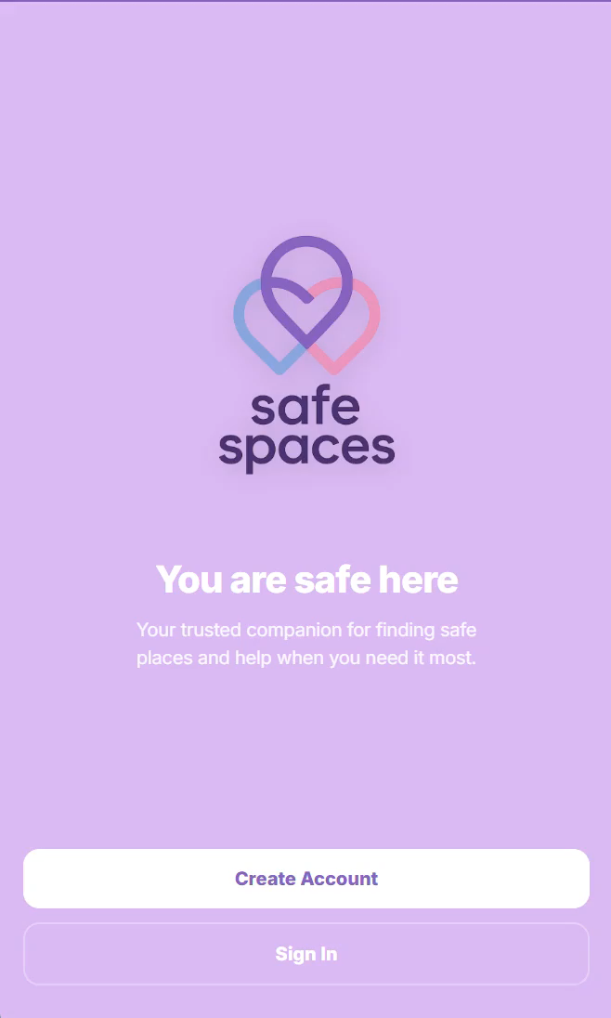
Prototype Walk-Through
Website link: https://safe-spaces-361fa.web.app/
Login details:
Email: jacquelinenyamandi@gmail.com
Password: Jk990429
OCT X 2025
SAFE SPACES
28

Slide 29
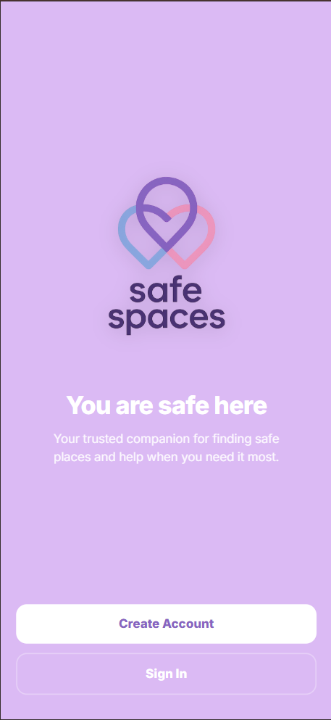
Summary
“Solving the problem. Securing the future.”
Our MVP Web Progressive App (PWA) delivers a practical, secure, and user-focused solution optimized for cellphone users. With Firebase-backed data security, an intuitive interface, and a lean pilot approach, we’re ready to test, learn, and scale quickly.
Why it matters:
Tackles a clearly defined problem with measurable impact
Prioritizes data integrity and user trust
Mobile-first PWA design ensures accessibility and convenience for users on the go
LINK: https://safe-spaces-361fa.web.app/
SAFE SPACES
OCT X 2025
29

Slide 30
THANK
-YOU
THANK
-YOU
THANK
-YOU
THANK
-YOU
OCT X 2025
THANK
-YOU

